Slide 1


K.RAMAKRISHNAN COLLEGE OF TECHNOLOGY
(AUTONOMOUS), TRICHY.
QUIZ APPILICATION
PRESENTED
AKASH . N
2303811710421006
SUPERVISOR
Mr. M. Saravanan, M.E.,
AP/CSE.

Slide 2
PRESENTATION OVERVIEW
Objective
Project Introduction
Problem Statement
Methodologies (Programming concepts relevant to problem statement)
Architecture of the proposed system
List of Modules
Merits
Results and Discussion
Queries

Slide 3
OBJECTIVE
This Quiz Application is a dynamic, interactive program designed to
create and conduct quizzes. It supports both user-defined and default
quizzes, with features like input validation, real-time feedback, and
performance analysis. Built using modular object-oriented principles,
it ensures scalability and ease of enhancement.

Slide 4
PROJECT INTRODUCTION
• The Quiz Application is an interactive platform designed to enhance learning and engagement through quizzes. Users can either create their own customized quizzes or participate in a preloaded General Knowledge quiz. The application provides a seamless experience with input validation, and immediate feedback on responses. Its modular design ensures flexibility, making it suitable for educational and entertainment purposes while offering scope for future enhancements

Slide 5
PROBLEM STATEMENT
Encapsulation: Data (questions, options, and correct answers) and related
methods are bundled together in classes like Question and Quiz, protecting
the internal details and providing a simple interface for interaction.
Modularity: The application is broken into separate classes and methods
(e.g., Question for individual questions and Quiz for managing the quiz
flow), making the code easier to maintain, extend, and debug.
Abstraction: Complex functionalities like displaying questions and
checking answers are hidden behind simple method calls, allowing users to
focus only on the core interaction (answering questions)

Slide 6
METHODOLOGIES
Planning and Requirements Analysis:
Identify target users(students, professionals, general public).
Wireframing and Prototyping:
Use tools like Figma, Adobe XD, or Sketch to design the user interface.
Database Design:
Plan relational database schemas for storing quiz data, user progress, and analytics.

Slide 7
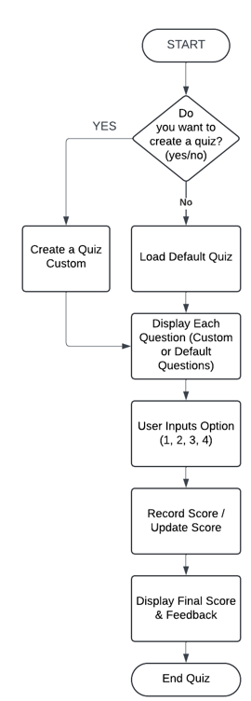
ARCHITECTURE OF THE PROPOSED SYSTEM

Slide 8
LIST OF MODULES
1. Quiz Creation Module
2. Question Display & Input Module
3. Scoring & Feedback Module
4. Default Quiz Loader Module
5. Input Validation Module

Slide 9
MERITS
Educational Benefits Interactive Learning: Encourages active participation, improving retention and understanding.
Entertainment Recreational Use: Fun and engaging way to pass time while also learning new facts.
Professional and Organizational Use Employee Training: Effective for collaboration among friends or groups.

Slide 10
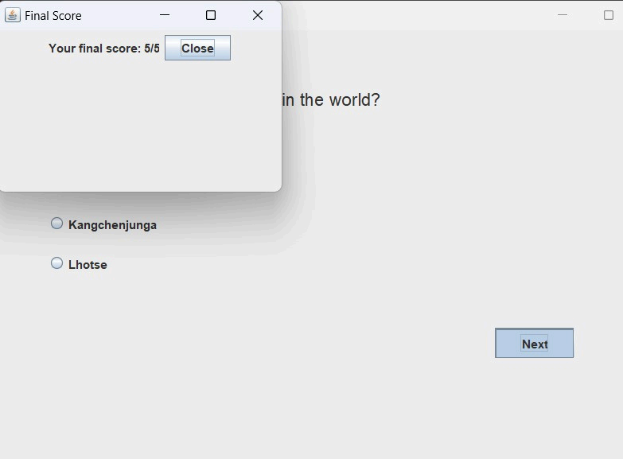
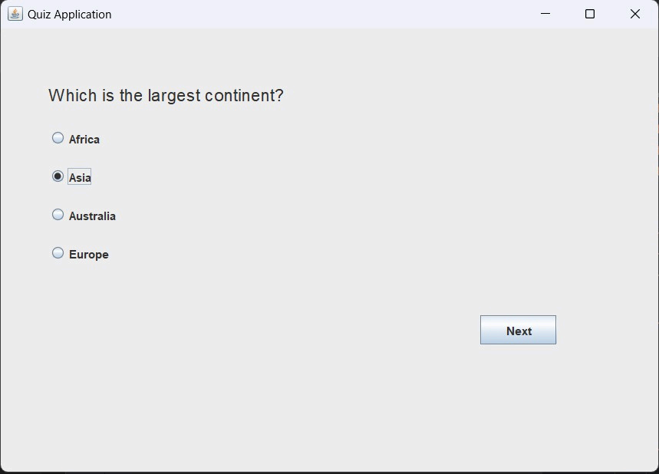
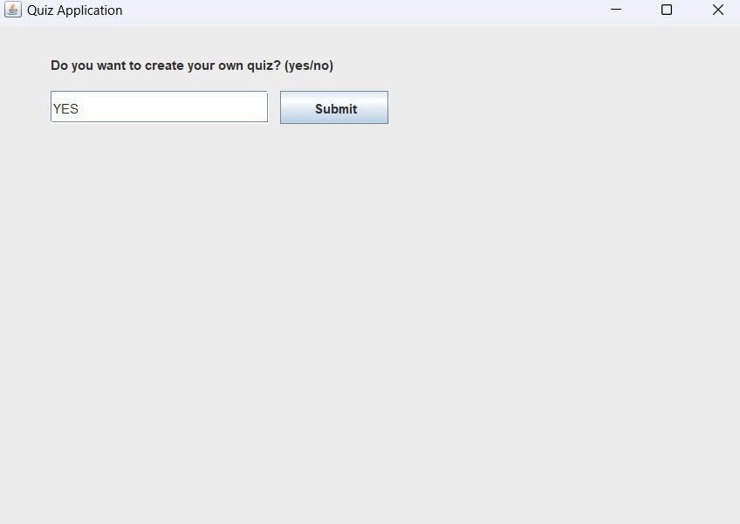
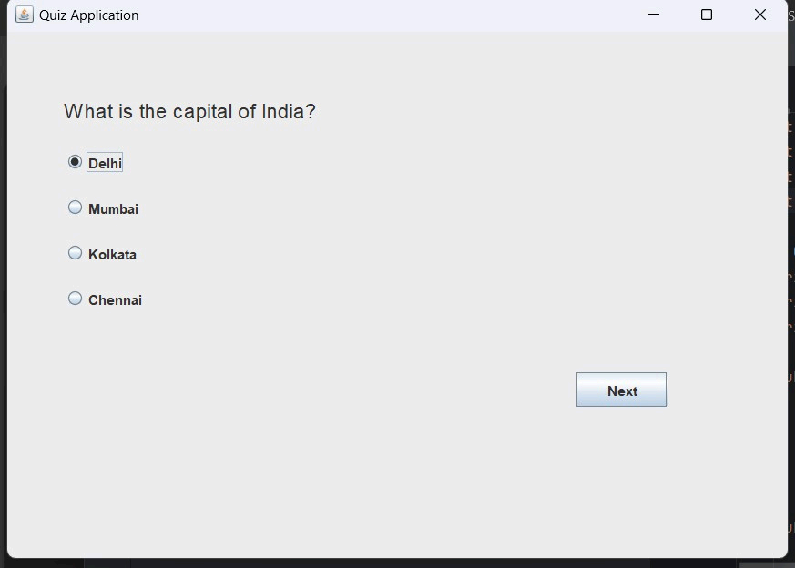
RESULTS AND DISCUSSION

Slide 11
QUERIES ?

